Slide 1


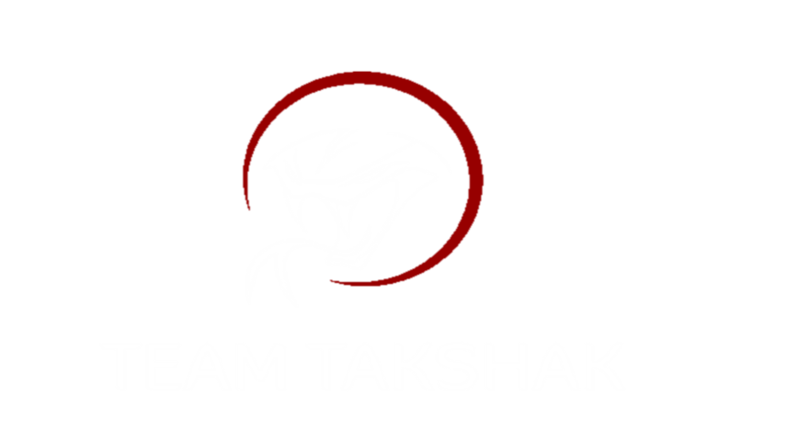
Takshak
Jagadambha College Of engineering and technology
AIRC 2020
TEAM
Faculty Adviser : Prof. R. U. Hedau
Team Captain : Mr. Shubham Chavhan

Slide 2
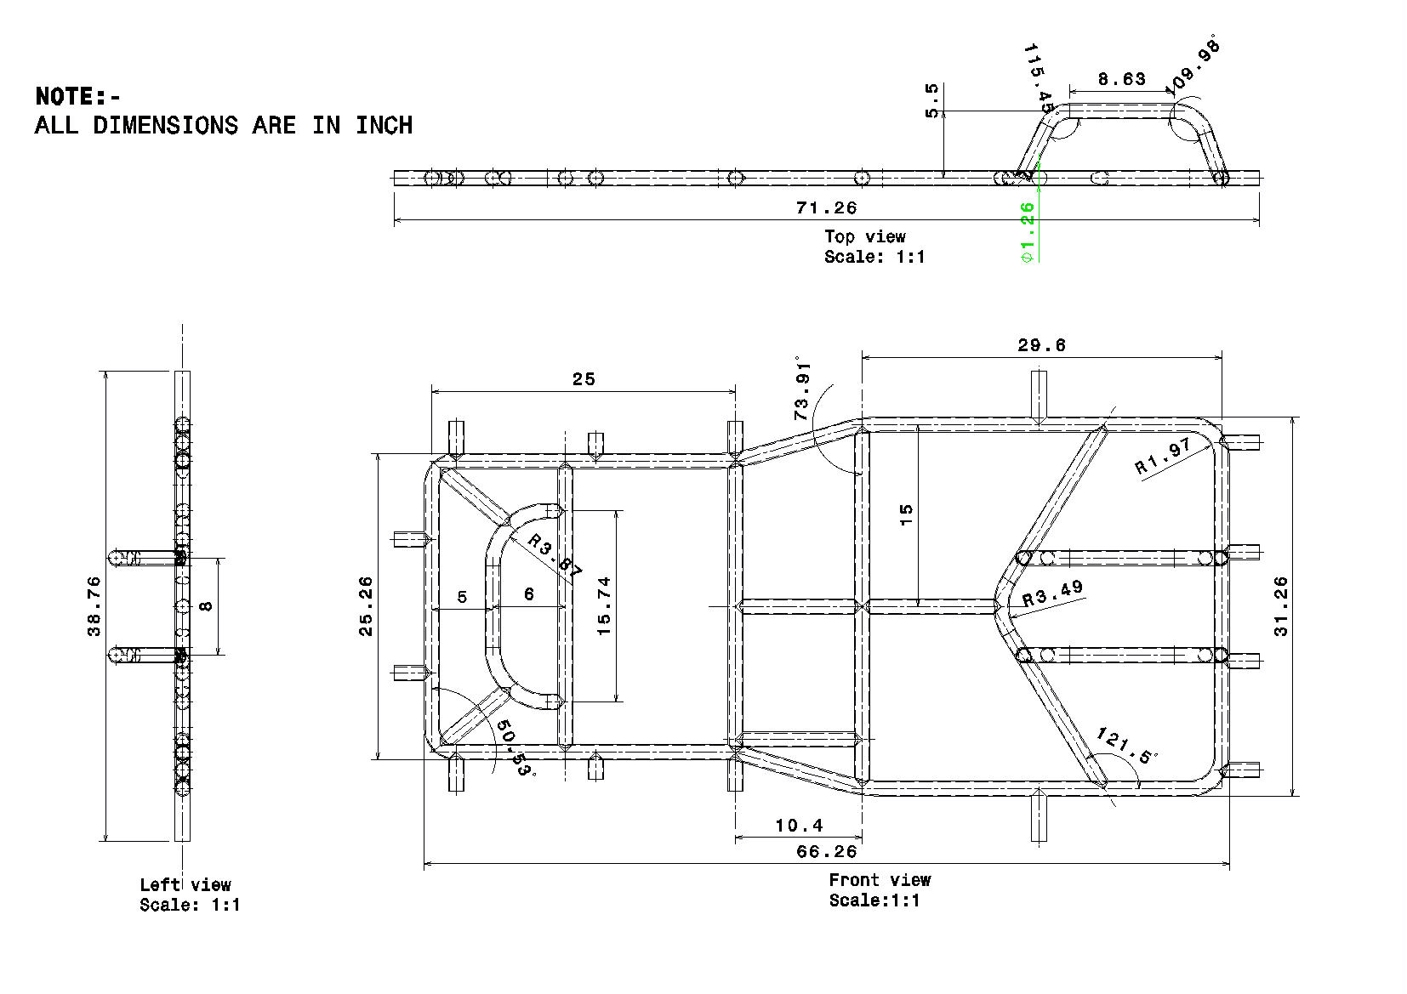
CAD MODEL

Slide 3
COMPUTER AIDEDE ENGINEERING (CAE)
Structural integrity of the frame was verified by comparing the analysis result with the standard value of the material. Analysis was conducted by use of the finite element analysis on ANSYS WORKBENCH 14.5 software to conduct finite element analysis of the chassis a CAD model of the design chassis ass uploaded from CATIA V5 R19, the stresses were calculated by simulating different induced load cases.
Front impact
Rear impact
Side impact
Static impact

Slide 4
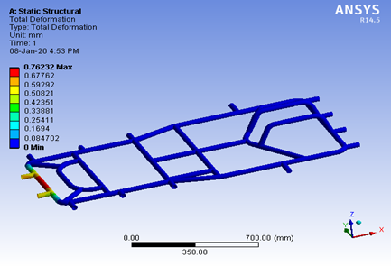
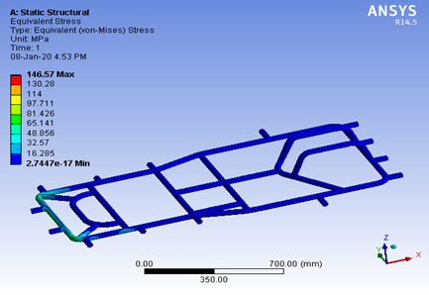
FRONT IMPACT
Here we assumed our vehicle to experience the impact force at a speed of 90km/hr. for a collision time of 1.05secs in the front region of our frame by applying constraints at the driver seat.
Since,
a = (90 - 0) / 1.05
= 90 × 1000) ÷ (60 × 60 × 1.05)
= 23.80 m/s²
Therefore,
F = 175 × 23.80
= 4165 N
FACTOR OF SAFETY
FOS = yield stress / working stress
= 435 / 146.57
= 2.96
TOTAL DEFORMATION
Maximum deflection= 0.7623 mm
EQUIVALENT VON-MISES STRESS
Maximum stress value = 146.57 MPa

Slide 5
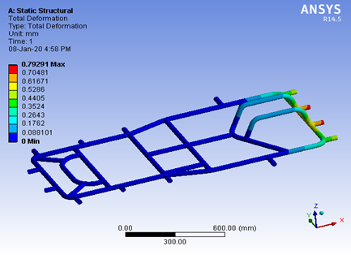
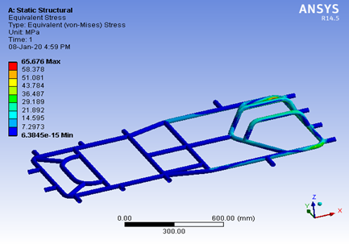
REAR IMPACT:
Here we assumed our vehicle to experience the impact force at a speed of 90km/hr for a collision time of 1.05secs in the rear region of our frame by applying constraints at the driver seat.
Since,
a = (90 - 0) / 1.05
= (90 × 1000) ÷ (60 × 60 × 1.05)
= 23.80 m/s2
Therefore,
F = 175 × 23.80 = 4165 N
TOTAL DEFORMATION
Maximum deflection = 0.79 mm
EQUIVALENT VON-MISES STRESS
FACTOR OF SAFETY
FOS = yield stress / working stress
= 435 / 65.67
= 6.62
Maximum stress value = 65.67 MPa

Slide 6
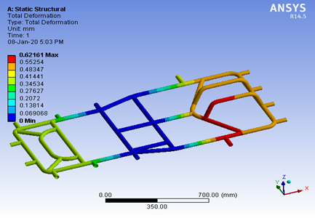
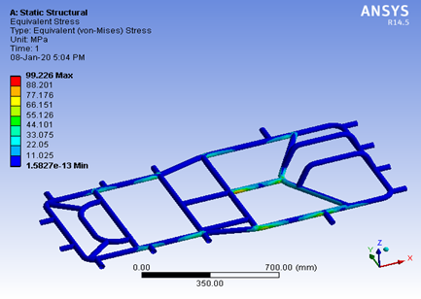
SIDE IMPACT:
Here we assumed our vehicle to experience the impact force at a speed of 90km/hr for a collision time of 1.05secs in the side region of our frame by applying constraints at the driver seat.
Since,
a = (90 - 0) ÷ 1.05
= (90 × 1000) ÷ (60 × 60 × 1.05)
= 23.80 m/s2
Therefore,
F = 175 × 23.80
= 4165 N
FACTOR OF SAFETY
FOS = yield stress / working stress
= 435 / 99.22
= 4.38
TOTAL DEFORMATION
Maximum deformation= 0.62 mm
EQUIVALENT VON-MISES STRESS:
Maximum stress value = 99.22 MPa

Slide 7
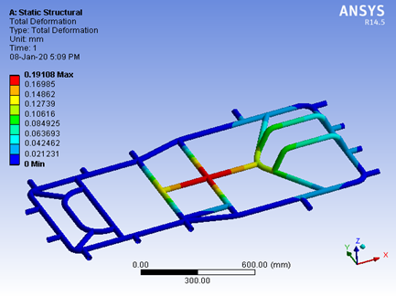
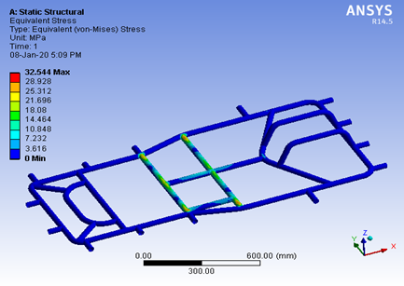
STATIC LOAD ANALYSIS:
The forces that have been imposed downward to the structural model. The load is distributed uniformly on member below of driver’s seat and engine compartment.
Load applied on the frame is 120Kg of chassis overall weight with all accessories and 55kg of driver.
Here we assume excess value of weight on frame.
Force = 120 + 55
= 175 * 9.81
=1716.75 N
FACTOR OF SAFETY:
FOS = yield stress / working stress
= 435/ 32.54
= 13.36
TOTAL DEFORMATION
Maximum deformation = 0.191mm
EQUIVALENT VON-MISES STRESS
Maximum stress value = 32.54 MPa

Slide 8
TABULATED RESULT:
PARAMETER | DEFORMATION (mm) | STRESS (MPa) | FOS | RESULT
Front | 0.76 | 146.57 | 2.96 | Safe
Rear | 0.79 | 65.67 | 6.62 | Safe
Side | 0.62 | 99.22 | 4.38 | Safe
Static Load | 0.19 | 32.54 | 13.36 | safe

Slide 9
STEERING MECHANISM
The steering system is used obviously to turn the go kart in desired direction us the important part is turning the go kart without causing, surging and tire squealing & not loosing control on the go kart.
These are many ways of making go kart steering assembly in go kart like ackermann and bogie steering system.
To make the control out go kart easiest & simplest we used steering mechanism of ratio 1:1.

Slide 10
DESIGN VALUE
Components | Dimensions
Tie Rod | 14”x0.5” Φ
King Pin | 3”x1.5”x11mm Φ
Bracket | 3.5”x1.5”x0.5” Φ
Bolt | 10mmΦ
Steering Shat | 20”x1”Φ
Steering Wheel | 10”
Geometry | Values
Caster angle | 0º
Camber angle | 12º
King pin inclination | 10º
Combined angle | 10º
Toe in | 5mm
Scrub radius | 1.5 inches
Inner turning radius | 2.1m
Outer turning radius | 3.4m

Slide 11
STEERING SPECIFICATIONS:
Sr. No. | Parameter | Dimensions
1 | Wheel base | 1219.2 mm
2 | Wheel track | 1041.4 mm (front) 1117.6 mm (rear)
3 | Inner Turning radius | 1998.93 mm
4 | Outer Turning radius | 3197.82 mm
4 | Pivot Centre | 762 mm
5 | Ackerman angle | 29.24˚
8 | Inner angle | 31.38 ˚
9 | Outer angle | 21.80˚
10 | Steering wheel radius | 162.5 mm
11 | Tie rod length | 460 mm
12 | Steering ratio | 1:1

Slide 12
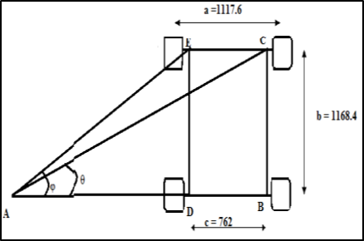
ACKERMANN ANGLE (α):
OUTER ANGLE (φ):
In triangle ABC, angle C = 90ᵒ.
(Assume Turning Radius (Ro) = 2499.2 mm)
Tan φ = b ÷ (R0 + a/2)
Tan φ = (1219.2 ÷ (2499.2 + 520.7))
φ = 21.980
INNER ANGLE (θ):
In triangle ADE, angle E = 90ᵒ.
Tan θ = b ÷ (R0 - a/2)
Tan θ = 1219.2 ÷ (2499.2 – 520.7)
θ = 31.640.
TURNING RADIUS:
a) Inner Turning Radius
R = b÷ tanθ
= 1219.2÷tan(31.64)
= 1978.68 mm
75% of wheelbase = 963.3458 mm
Tan α = (a / 2) ÷ (0.75 × b)
Tan α = (1117.6/2) ÷ ( 0.75×1168.4)
α = 39.500

Slide 13
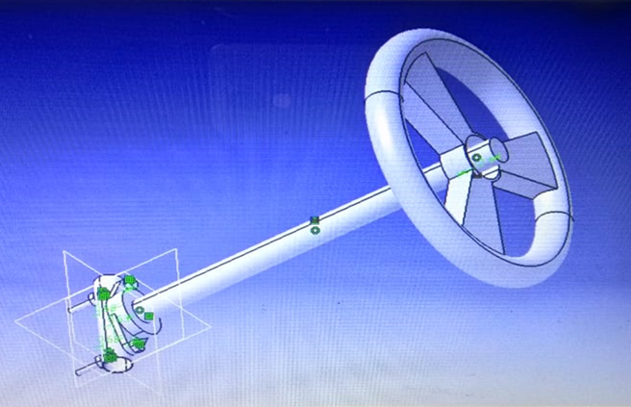
b) Outer Turning Radius
Rmax = b÷sin φ + (a-c÷2)
= 1219.2÷sin21.98 + (1041.4-762÷2)
= 3197.82 mm
STEERING RATIO: 1:1
The ratio 1:1 is chosen to achieve less lock to lock angle
TIE ROD LENGTH:
Sin α = y ÷ r
Where,
r = radius of the steering wheel
α = Ackermann angle
Sin 39.50 = y ÷ 160
y = 101.77 mm
Lt = c – (Sin α x 2 x y)
Where,
Lt = tie rod length
C = kingpin to kingpin length
Lt = 787.4 – (Sin 39.50 × (2 × 101.77))
Lt = 657.93 mm

Slide 14
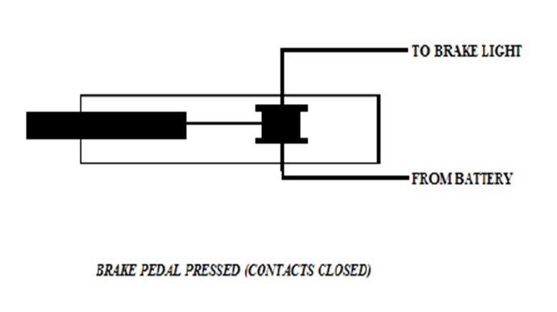
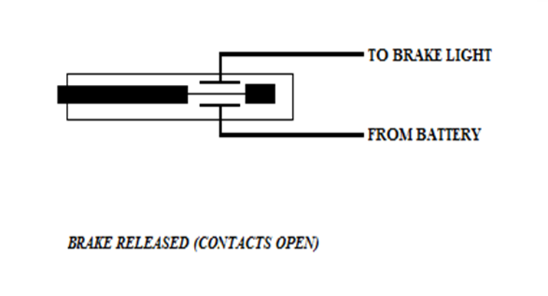
BRAKING SYSTEM
BRAKING PRINCIPLE:
It goes without saying that brakes are one of the most important control component of vehicle. They are required to stop the vehicle within the smallest possible distance and this is done by converting the kinetic energy of the vehicle into the heat energy which is dissipated into the atmosphere.

Slide 15
BRAKE SYSTEM SPECIFICATIONS:
SR.NO | CONTENTS & TYPES | SPECIFICATION
1 | Disc Outer Diameter | 170mm
2 | Disc Inner Diameter | 43mm
3 | Disc Thickness | 3mm
4 | Gross Weight Of The Vehicle | 1716.75 N
5 | Pedal Ratio | 4:1
6 | Break Line Pressure | 12.3887 Mpa
7 | Clamping Force | 19897.0885 N
8 | Rotating Force | 13927.962 N
9 | Braking Torque | 741.663 NM
10 | Coefficient Of Friction | 0.6
11 | Braking Force | 5393.9127 N
12 | Deceleration | 30.822 m/sec
13 | Stopping Distance | 4.00 m
14 | Braking Time | 1.667 sec
15 | Kinetic Energy | 10800.30 J
16 | Braking Power | 6478.70 N
17 | Area of Master Cylinder | 113.0973 mm²
18 | Area of Caliper | 804.2777 mm²

Slide 16
BRAKE CALCULATIONS:
1) Weight Distributions:-
Gross weight of the kart = 175 kg
Front / rear = 2 ÷ 3 = 2:3
Gross Weight of the Vehicle:-
W = weight of the vehicle in kg × 9.81
= 175 × 9.81
W = 1716.95 N
2) Brake Line Pressure:-
P = force on the brakes / area of master cylinders
Assume the normal force applied on the pedal=350 N
Pr = pedal ratio × force on pedal ÷ π / 4 × d2
= 4× 350 ÷ π / 4 × (12)2
Pr = 12.3787 Mpa
3) Clamping Force:-
Cf = brake line pressure × (area of calliper × 2)
=12.3787 × (π ÷ 4 × (32)2 × 2)
Cp = 19897.0885 N
4) Rotating Force:-
Rf = Cf × no. of caliper pistons × coefficient of friction of brake pads
= 19897.0885 ×0.35 ×2
Rf = 13927.962 N
5) Braking Torque:
Tn = rotating force × effective disc radius
= 13927.962 × 170+43÷4
=13927.962 × 0.05325
Tn = 741.663 NM
This is the torque available at two tires of rear shaft
6) Braking Force:-
Bf = braking torque / tyre radius × efficiency
= 741.663 ÷ 0.11 × 0.8
Bf = 5393.9127 N

Slide 17
7) Deceleration:-
Bf = -ma
Negative sign indicates the force in opposite direction
a = -braking force / m
= -5393.9127÷ 175
a = -30.822 m/sec
8) Stopping Distance:-
S = v2 – u2 ÷ a
= (11.11)2 ÷ 30.822
S = 4.00 m
9) Braking Time :-
t = stopping distance × reaction time ÷ 3.6
3.6 is the fixed fig for converting km/hr to m/sec
t = 4.00×1.5÷3.6
t = 1.667sec
10) Kinetic Energy:-
KE = 1 ÷ 2 × mv2
= ½×175× (11.11)2
KE = 10800.30 J
11) Braking Power:-
Bp = KE / t
=10800 ÷ 1.667
Bp = 6478.70 N
12) Area Of Master Cylinder:-
Amc = π ÷ 4 × D2
D =12mm
Amc = π ÷ 4 × (12)2
Amc = 113.0973 mm2
13) Area Of Caliper:-
Ac = π ÷ 4 × D2
D = 32 mm
Ac = π ÷ 4 × (32)2
Ac = 804.277 mm2

Slide 18
ENGINE & TRANMISSION:
We Selected Bajaj Pulsar 135 cc Engine 4-stroke petrol With Carborettor and Gravity Fuel system.
SR NO | DESCRIPTION | TYPE
1 | Displacement | 135 cc
2 | Stroke | 4 stroke single cylinder
3 | Cooling | Air cooled
4 | Max power | 13.56 BHP @ 9000 rpm
5 | Max Torque | 11.4 N-m @ 7500 rpm
6 | Cylinder | Single
7 | Bore | 50 mm
8 | Fuel delivery system | Carburettor
9 | Fuel | Petrol
10 | Ignition | Digital CDI
11 | Transmission Type | Chain Drive
12 | Clutch Type | Wet Multi plate type
13 | No. Of Gears | 5
14 | Gear Box type | Manual

Slide 19
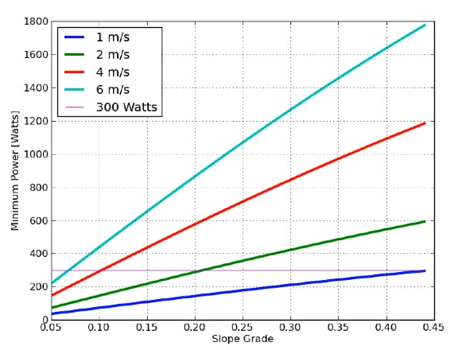
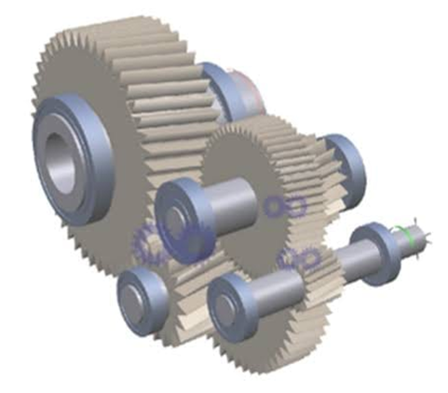

Slide 20
T = 9000×3.9×3.076×2.28
T = 1312.2 N.M
T = Π / 16 × d3× τ
τ = Working stress
312.2 = Π/16× (0.04) × τ
τ = 24844086 N/m2
τ =24.8 N/mm2
Factor of Safety = Mass stress /Working Stress
= 310/24.8
= 12.5
3) Tractive Force =U×m×g
U= strees = 0.6×180×9.81
Ft=1059.48 N
4) Starting Torque = Ft ×R
= 1059.48 × 0.1397
=148 N m
POWER TRAIN CALCULATION:
Shaft Diameter: 40mm
Tire Radius: 0.1397m
Tire Diameter: 0.2797m
Final Drive Ratio: 2.28
Engine speed (rpm) = 10×Primary Reduction Ratio ×5th gear ratio ×F×S
1) For Speed
S = engine rpm / 10 × p.r.r ×5th Gear ×Final Drive
S = 9000/10×3.9×0.9523×2.28
S =105 km/hr
2) Working Stress
Torque at wheel = Engine Torque × Primary Production Ratio ×First Gear Ratio ×Final Drive Ratio

Slide 21
CONCLUSION
The team takshak has used finite element analysis system to evaluate create and modify the best vehicle design to achieve its set goals. The main goal is to manufacture a kart which is similar to professional karts and at the same time to make it more light weight without sacrificing performance and durability. The result is lighter , faster and more efficient vehicle that improves go-kart design to a new extent. And also finally we thank our institution and AIRC for giving us this opportunity.

Slide 22
Thank You

